Slide 1


New Year, Happy Holidays, winter icons
and backgrounds
These InfoDiagram illustrations are built in Microsoft PowerPoint 2010 and provided in PPTX (Open XML) format. The illustrations can be imported also into older PowerPoint versions (PPT files), MS Word or MS Excel, MS Office applications for Apple, Keynote or OpenOffice Impress – in all applications able to open the standard PowerPoint file (PPTX format).
Author: infoDiagram designer
License: standard
(commercial use, 1 user, no reselling rights, no right to give to third person)
In case of questions, license extensions etc. don’t hesitate to contact us: hello@infoDiagram.com

Slide 2


We designed these slides to help you do creative seasonal greetings for your family, colleagues or clients. Enjoy.
Support us creating more graphics.
Just share a word about us.
Thanks, thousand times.
Happy 2026 to you!
Izabela, Peter and Marcin,
and Your Prezentio & infoDiagram team
Store
www.infodiagram.com
Email Newsletter & Free graphics https://www.infodiagram.com/freesample
  LinkedIn
  www.linkedin.com/company/infodiagram-com
  YouTube
  www.youtube.com/infodiagram
  Blog
  blog.infodiagram.com

Slide 3

Enjoy our winter holidays creative art collection
I designed for you with love.
Use it to made a creative presentation
or greetings for your families and friends.
Stay safe and healthy.
Izabela
infoDiagram chief designer
For better experience download and install free font Amatic
You can download it here:
http://www.fontsquirrel.com/fonts/amatic

Slide 4
New Year Resolution List Template
My
2026
To-Do List
Meditate or reflect every day
Eat better. No processed meat
Read a book a month
Attend online training…

Slide 5

Marketing Calendar 2026 - Holidays and Observances
December
January
February
March
April
May
Dec 25: Hanukkah
Dec 25: Christmas
Dec 31:
New Year’s Eve
Jan 1: New Year’s Day
Winter Holidays
Feb 9: Super Bowl
Feb 14:
Valentine’s day
Feb 16:
Presidents Day
Feb 17: Chinese New Year
Mar 8: Int’l Women’s Day
Mar 17: St. Patrick’s Day
Mar 20: First Day of Spring
Mar 29:
Daylight Saving
Apr 1: April’ Fool's Day
Apr 5: Easter
May 1: Int’l
Labor Day
Mar 14: Mother’s Day
Mar 29: Memorial Day
Holiday
Next months
Jun 18: Fathers Day
Jul 4: Independence Day
Oct 9: Columbus Day 2023
Oct 31: Halloween
Oct 25: Daylight Saving End
Nov 11: Veterans Day
Nov 26: Thanksgiving
Dec 25: Christmas Day

Slide 6



Slide 7

Merry Christmas
and Happy New Year
2026

Slide 8
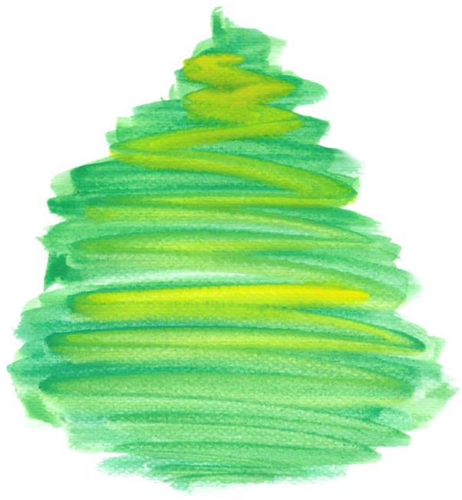


Slide 9


Slide 10
Holidays outline icons

Slide 11
Snowflakes

Slide 12
Christmas icons

Slide 13
New Year’s Eve Celebration

Slide 14
Ornaments

Slide 15
Editable colors

Slide 17

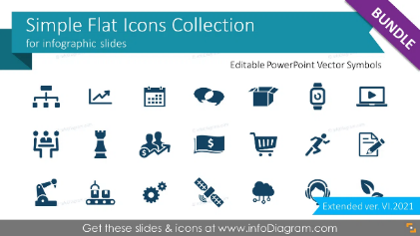
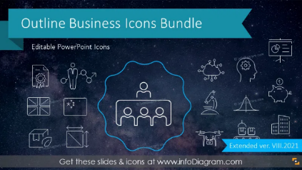
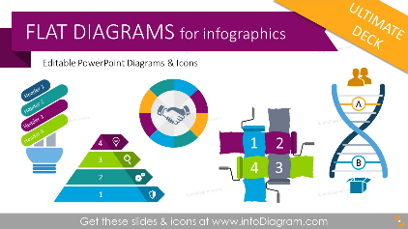
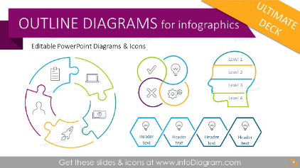
See & get more PPT graphics
Browse: www.infoDiagram.com

Slide 18
Additional services
Training
Data Visualization
in
PowerPoint
AI ChatGPT
for presentations
Monthly online practise
Practise & Coaching – individual or group sessions monthly.
Ongoing improvement of slide design skills, where you can work on your slides with our guidance
Company training adjusted to your template, materials and needs
See portfolio and training offer at: www.prezentio.com
Slide content facelifting
Slide-deck Visualization system
Design Services
Stay informed + get bonus PPT
Join our newsletter (leave anytime)
https://prezentio.com/newsletter-ppt-tips/
or follow us on LinkedIn
https://www.linkedin.com/in/peterzvirinsky/
Presentation
Template
updates

